Slide 1


Welcome to class A
2025-2026
Teacher: Nikoletta Taliadorou

Slide 2
General Educational Goals
To create happy, responsible, and productive citizens.
To respect others and love the environment.

Slide 3
What we ask for is...
Children who:
Take responsibility.
Complete the tasks assigned to them.
Do not justify their mistakes by blaming others.

Slide 4
Responsibility
Essentially, boundaries mean Love and Care.
A child needs discipline in order to feel safe, define themselves and their space, and gradually become independent, taking their own steps in life.

Slide 5
Why do children need rules?
A child who grows up without rules and clear boundaries is not free.
On the contrary, they are trapped in an unclear and complicated structure where responsibility and cooperation cannot develop.
Setting conditions may feel harsh—even for you as parents—but it is necessary.

Slide 6
Boundaries – Discipline – Safety
By setting boundaries for your child’s behavior from an early age, you help them face disappointments and limitations later in life with respect and critical thinking. They will accept these more easily, without behaving selfishly or unfairly.

Slide 7
1. Clear and Simple Terms
Set the rules from the start, not after the child becomes demanding.
Example: When the child asks to watch TV before studying, you make it clear that the agreement is only for 30 minutes, and then the TV turns off. You also explain the reasons.

Slide 8
2. Respect the Limits You Set
If the rule is 30 minutes, keep it.
Do not give in to crying, whining, or begging.
Otherwise, the child learns that everything is negotiable, and boundaries break with a little pressure.
You also lose credibility, and the child won’t respect you.

Slide 9
3. Do Not Give In to Begging
Begging is the big weapon of children. If you give in once, they learn that they can manipulate you with drama (“I need more TV,” “you don’t love me”).
Stay calm, explain in a steady voice why the rule exists.

Slide 10
4. Require Tasks Before Rewards
Teach children to finish obligations first (tidy up toys, put things back) before doing what they want.
Example: No TV until toys are put away. If not done, TV is withheld. Remain firm and consistent.

Slide 11
5. Don’t Be Afraid to Let Them Feel Disappointment
Don’t fulfill all their wishes. Although it’s hard to see your child upset, they must learn that they cannot always have what they want.
Strictness helps them face disappointment in life.

Slide 12
Help Them Become Independent and Responsible
Do not trap them in childish behaviors.

Slide 13
Disciplined – Independent Children
Establish daily routines: children need structured programs to develop discipline.
Praise disciplined behavior: say “Bravo!” every time they show self-discipline.
Example: “Well done for sitting to study without me asking!”
Be a role model of self-discipline.
Do not allow children to manipulate you or exploit disagreements between parents and teachers.

Slide 14
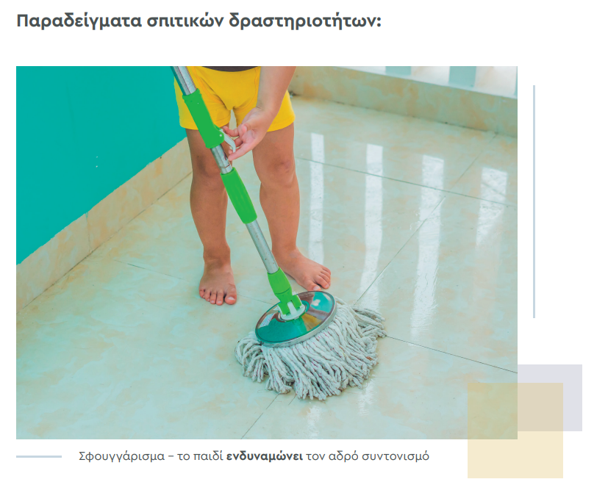
Activities that contribute to empowerment

Slide 15
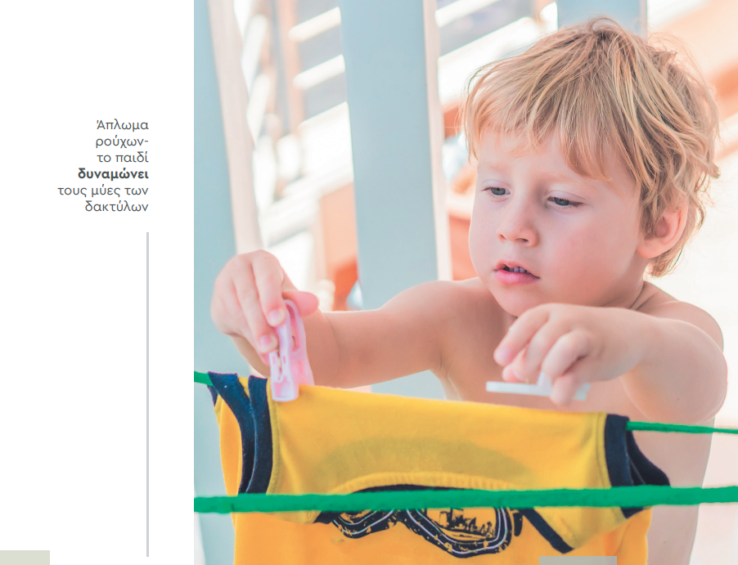

Slide 16
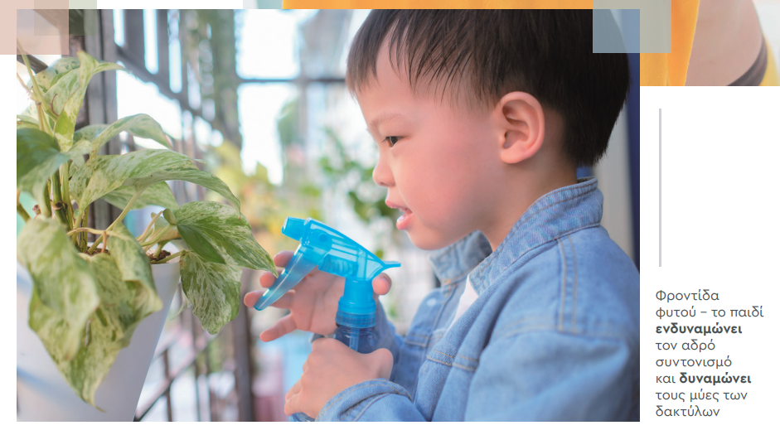

Slide 17
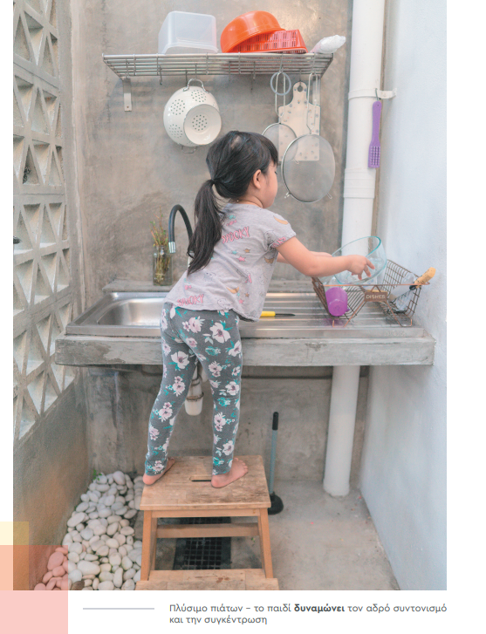

Slide 18
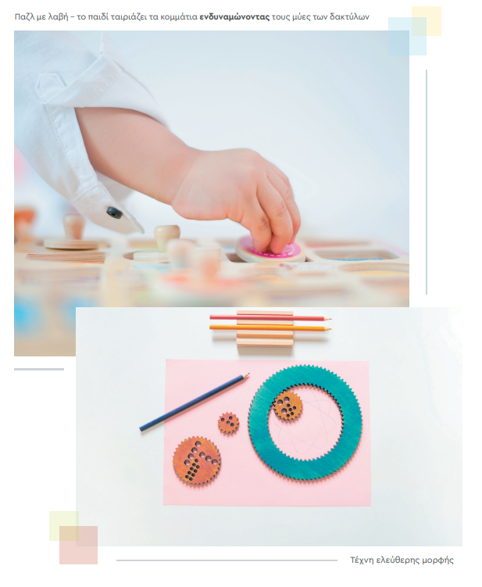

Slide 19
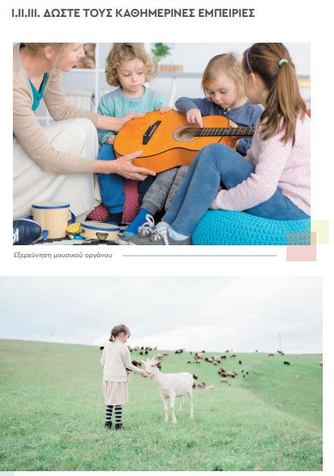

Slide 20
Activities That Strengthen Children
Good habits – in class:
Arrival time.
Communication folder – kept clean.
Greek folder – contains books and A5 “Reading Cards.” Corrected worksheets stay at home. Notebooks stay in class.
Math folder – book + booklets.
Sharpened pencils & colored pencils daily.
Eraser, ruler, scissors in pencil case.
Food and water.
Spare clothes.

Slide 21
Good habits – at home:
Dedicated study space & time.
Initial guidance → then independent studying. Parent reads instructions from “Our News,” child finds correct folder/book/page, then works independently.
Child prepares school bag (books, worksheets, sharpened pencils). Parent checks.
Insist on neat handwriting and tidy coloring.

Slide 22
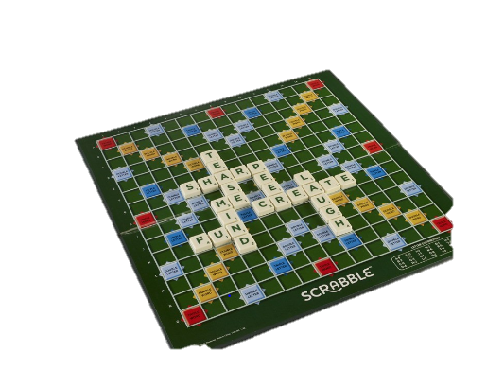
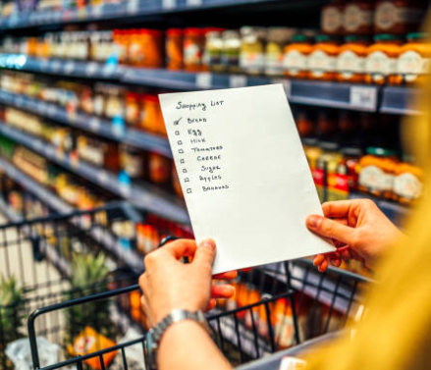



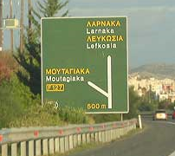
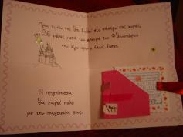

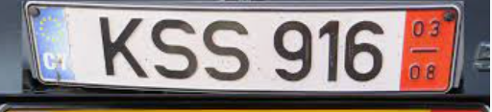


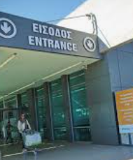
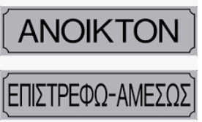
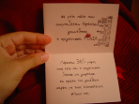
Good habits – at home:
Notes:
Περάστε καλά με τα παιδιά σας παίζοντας και μαθαίνοντας.

Slide 23
Grade A Language Goals
Acquire reading mechanism: Read and understand.
Produce written text: Write full, meaningful sentences.

Slide 24


First Reading & Writing
Whole-word method: Visual recognition of words.
  Negative: Time-consuming
  Positive: Smooth reading
Phonics method: Teaching letters and syllables.
  Negative: Robotic reading
  Positive: Quick results, decode unknown words

Slide 25
Teaching a Letter
(2–3 Days)
Day 1:
Picture and text
Discussion, meaning, punctuation, characters
Whole-word recognition
Find the letter – sound (not name) → e.g. p not pee
Example words: grandpa, melon, ice cream, bicycle, parrot
Practice writing and vocabulary

Slide 26
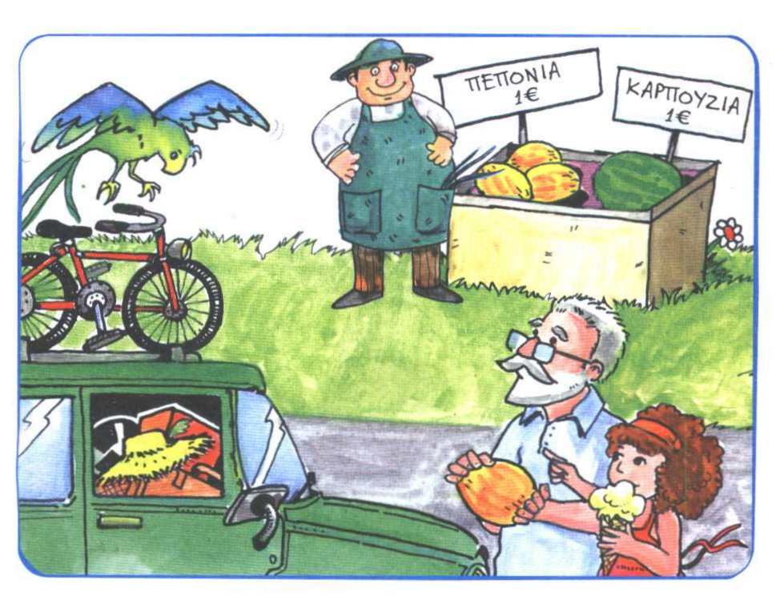
παπαγάλος
ποδήλατο
παππούς
πεπόνι
παγωτό

Slide 27
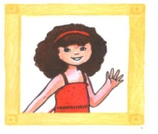
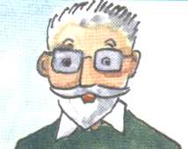
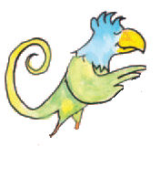
Πεπόνι, πεπόνι!
Παππού , ένας παπαγάλος !
- Παπαγάλε , θέλεις πεπόνι ?
- Πεπόνι , πεπόνι.
- Παπαγάλε , θέλεις παγωτό ?
Παγωτό , παγωτό .

Slide 28
Πεπόνι, πεπόνι!
Παππού , ένας παπαγάλος !
- Παπαγάλε , θέλεις πεπόνι?
- Πεπόνι , πεπόνι.
- Παπαγάλε , θέλεις παγωτό ?
Παγωτό , παγωτό .

Slide 29
Πεπόνι, πεπόνι!
Παππού , ένας παπαγάλος !
, ένας παπαγάλος !
- Παπαγάλε , θέλεις πεπόνι?
- Πεπόνι , πεπόνι.
- Παπαγάλε , θέλεις παγωτό ?
- Παπαγάλε , θέλεις ?
Παγωτό , παγωτό .

Slide 30
Πεπόνι, πεπόνι!
Παππού , ένας παπαγάλος !
- Παπαγάλε , θέλεις πεπόνι?
- Πεπόνι , πεπόνι.
- Παπαγάλε , θέλεις παγωτό ?
Παγωτό , παγωτό .

Slide 31
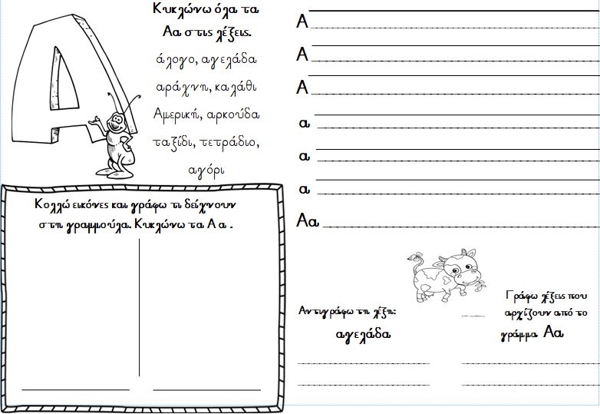

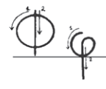
Writing Practice:
Correct stroke order
Correct letter size
Proper placement on the line

Slide 32
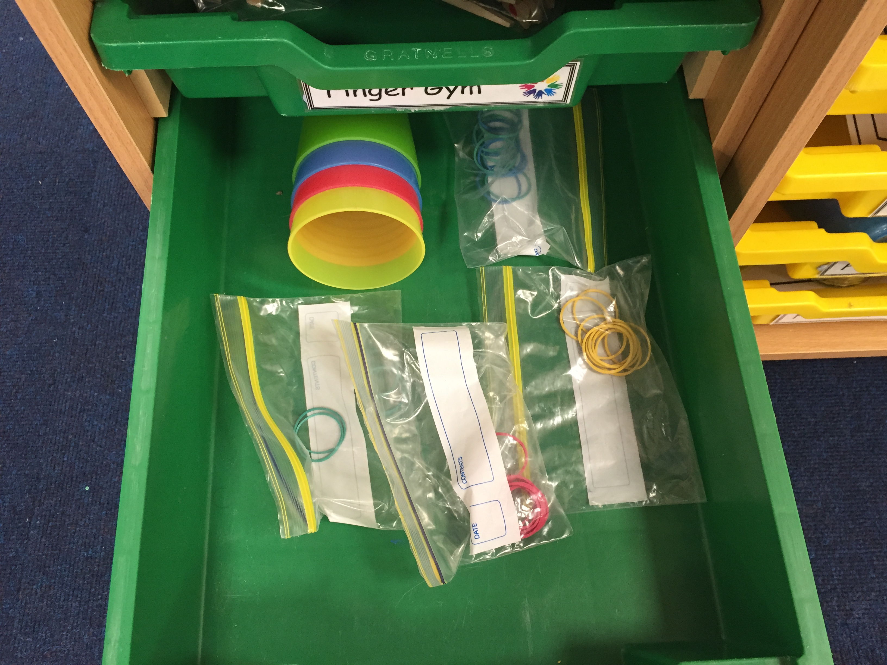
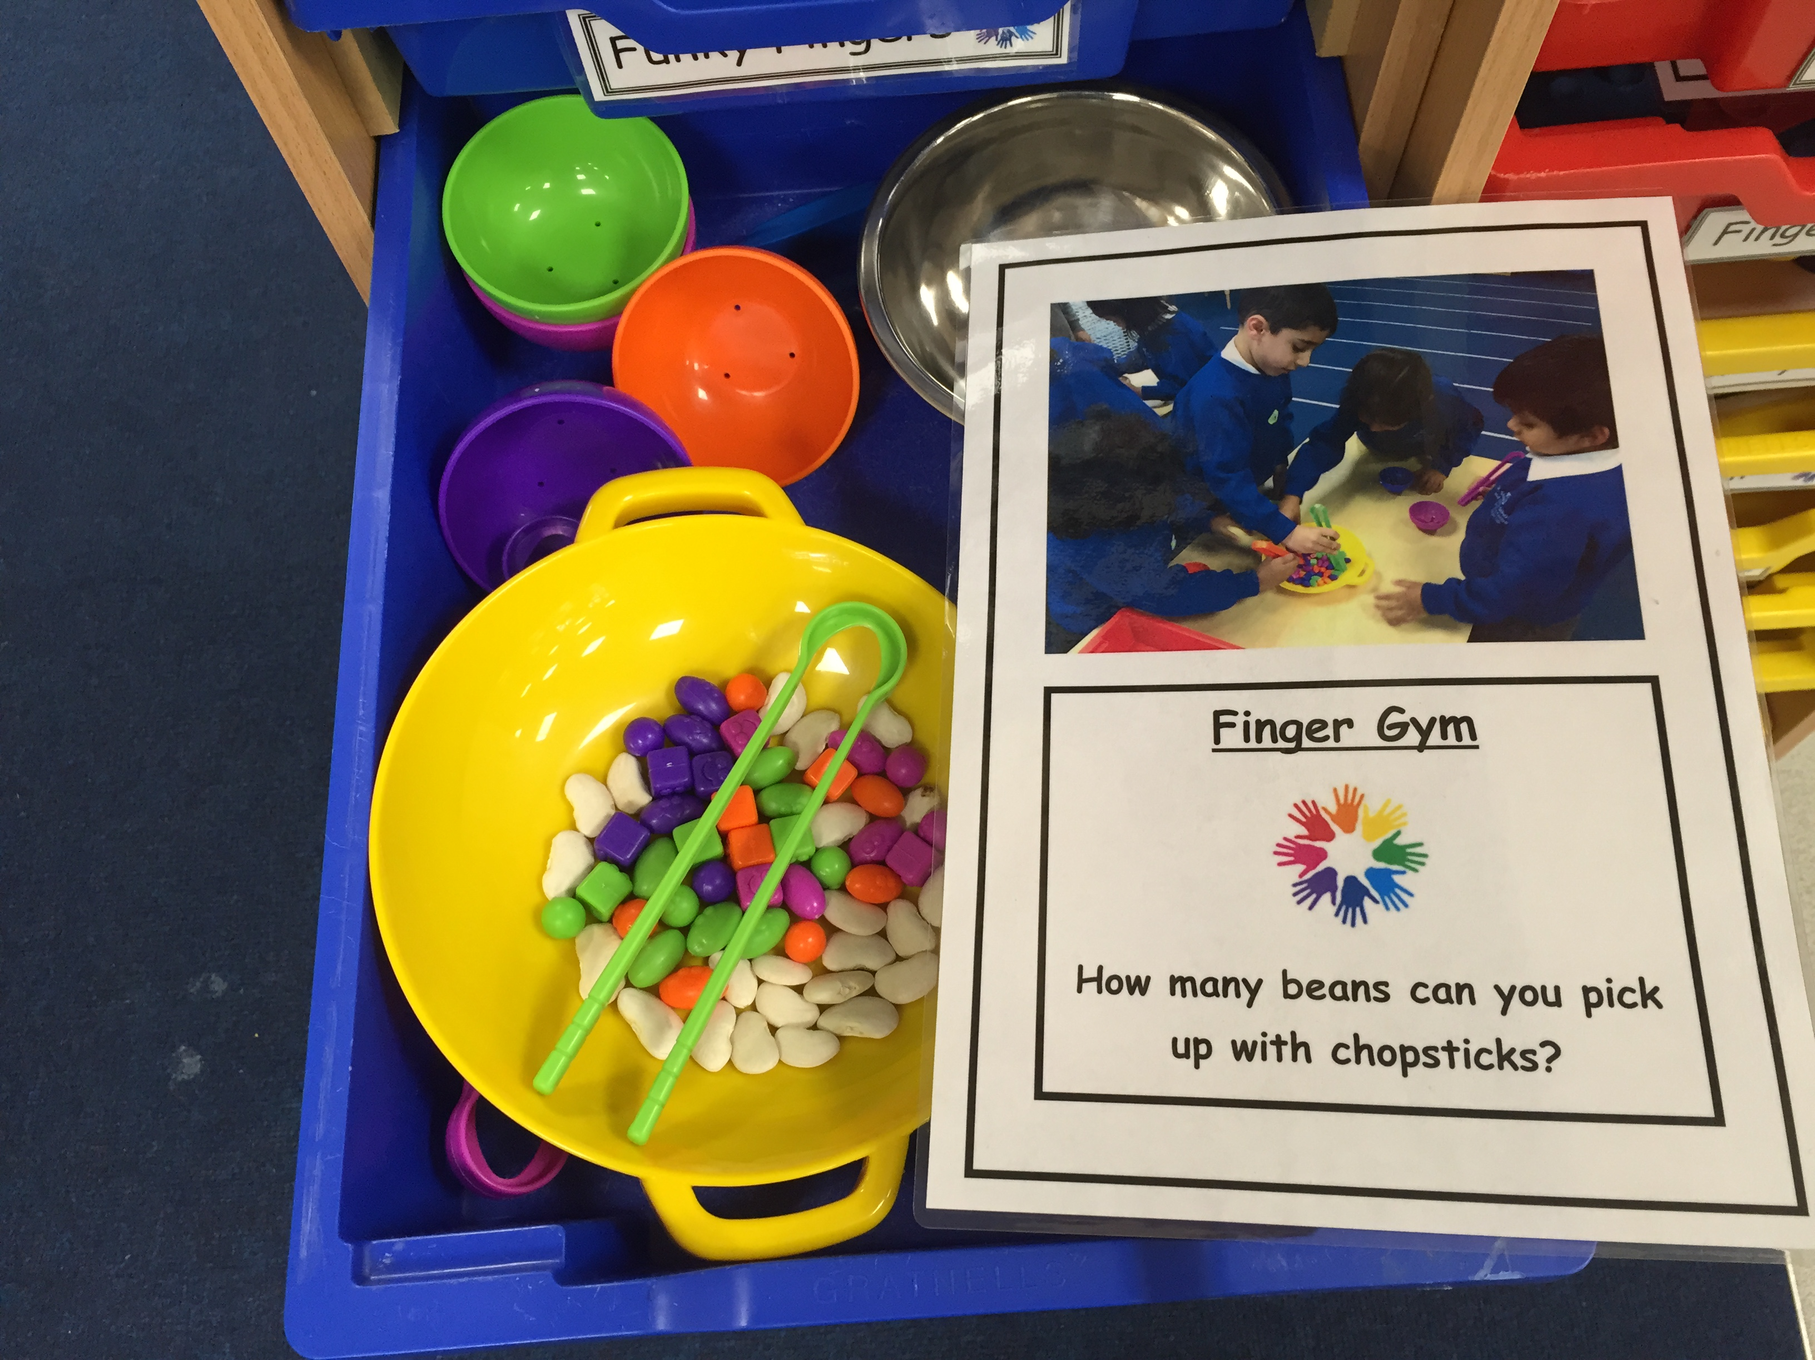
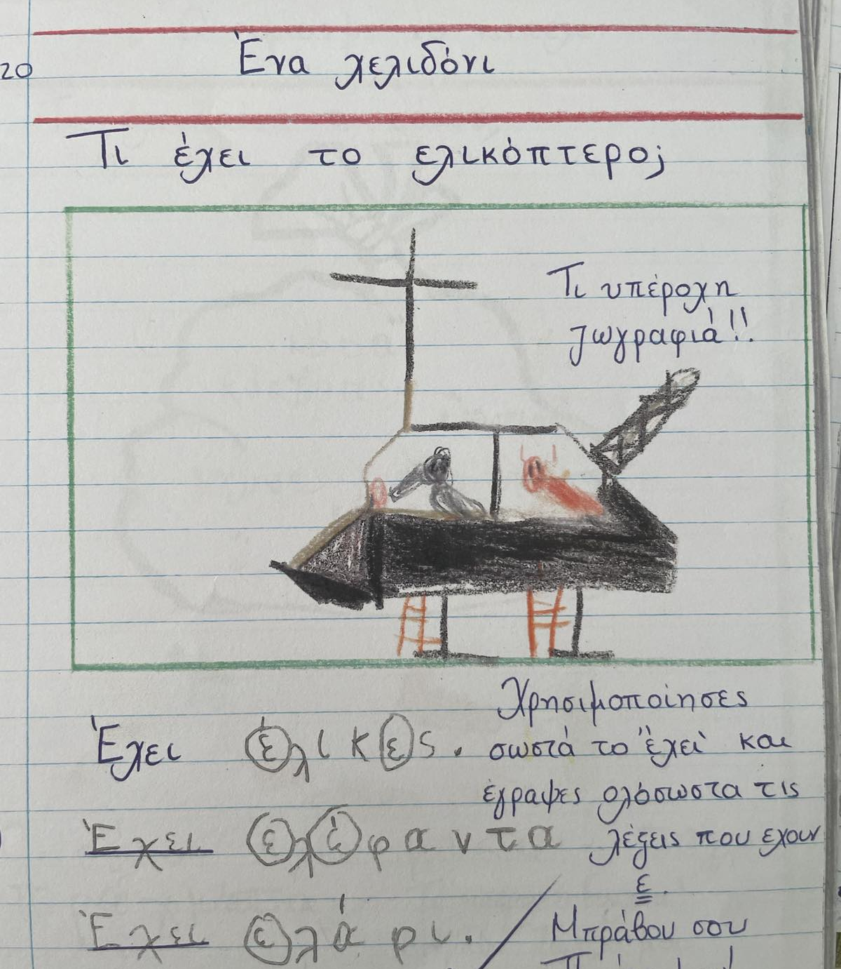
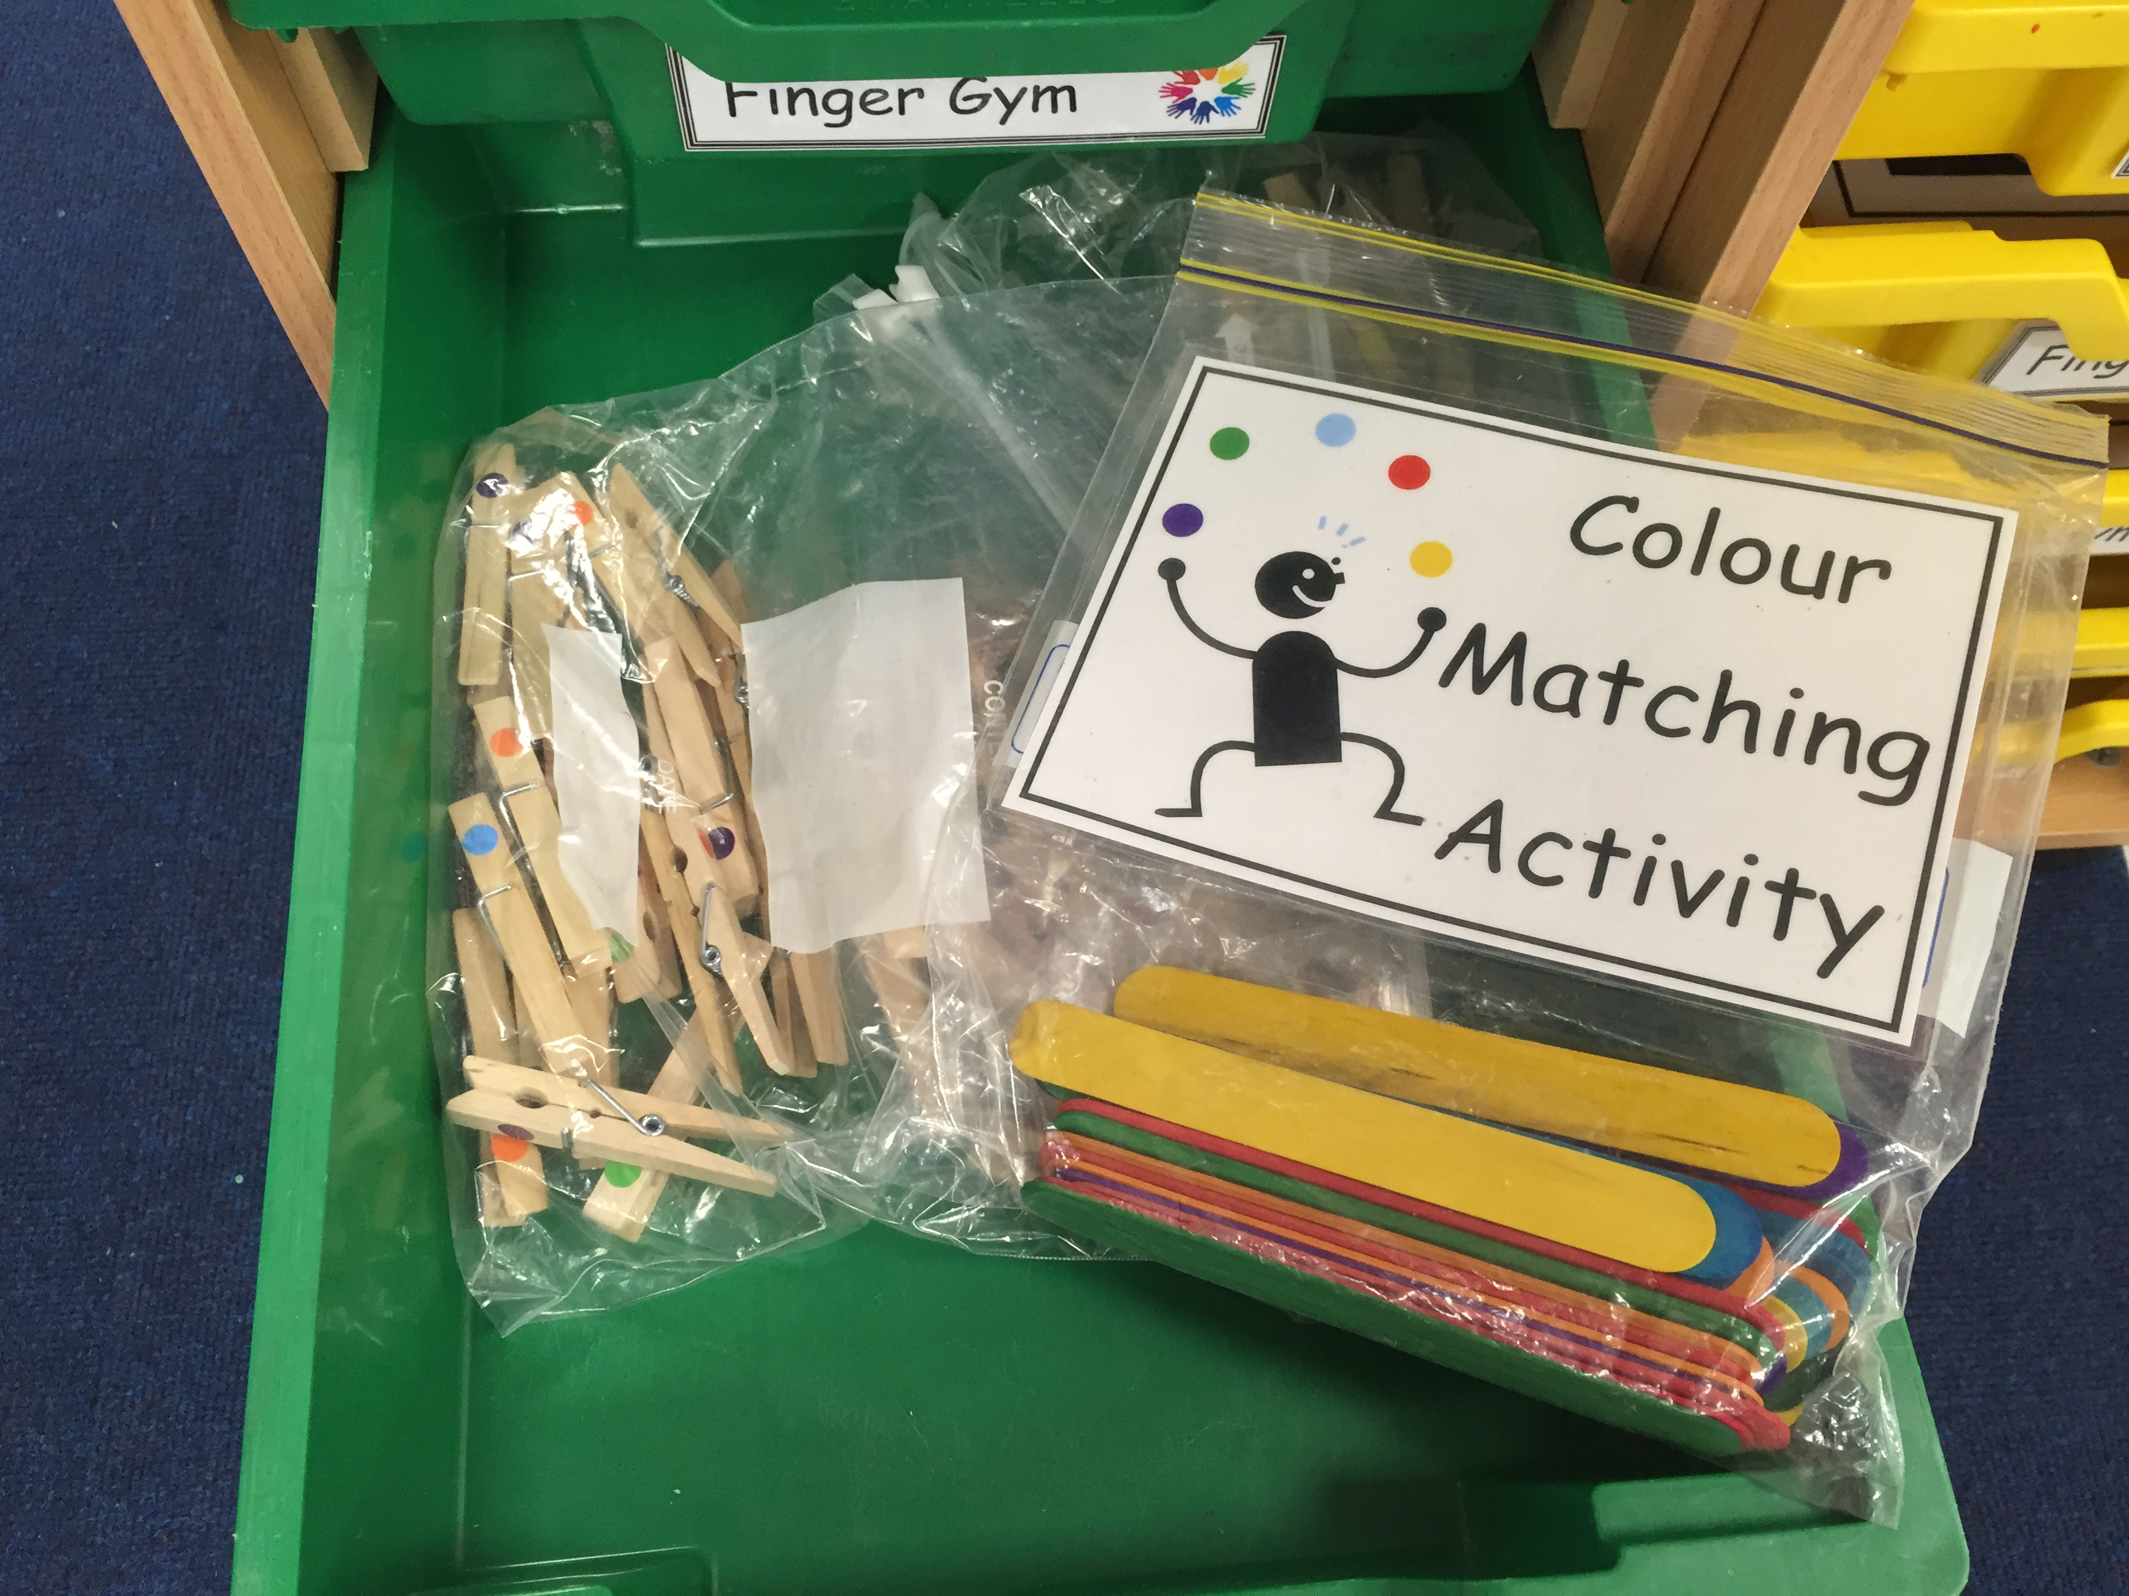
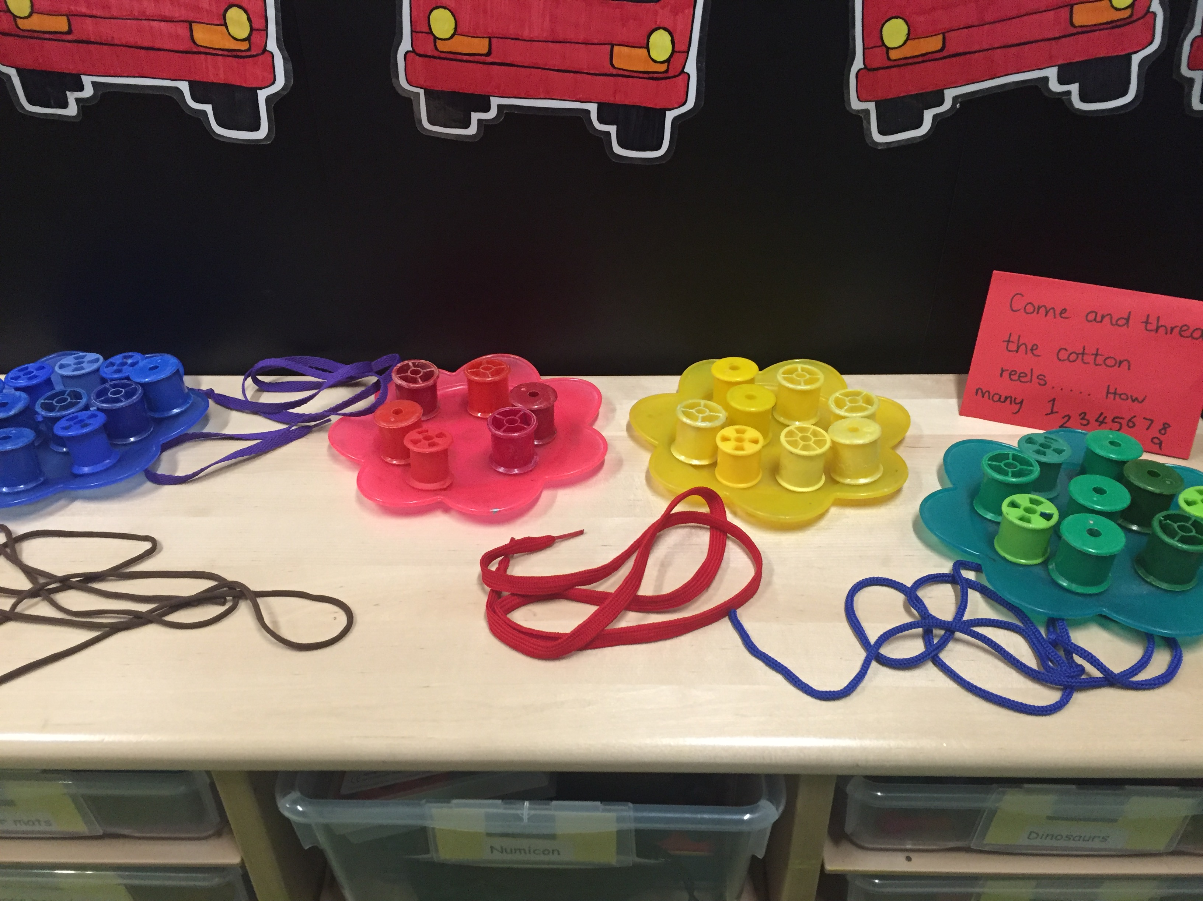
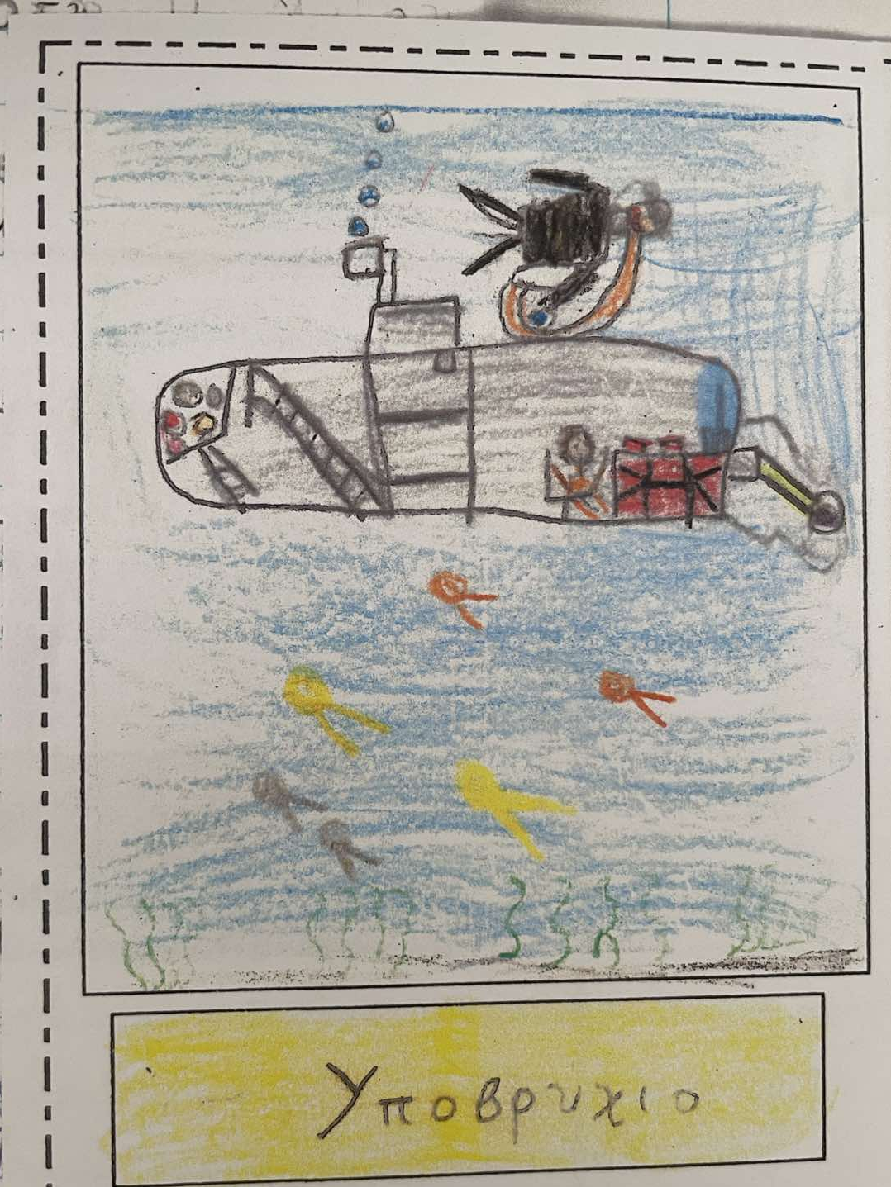
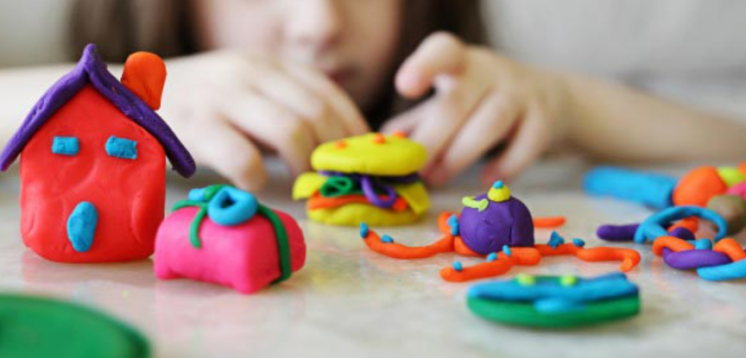
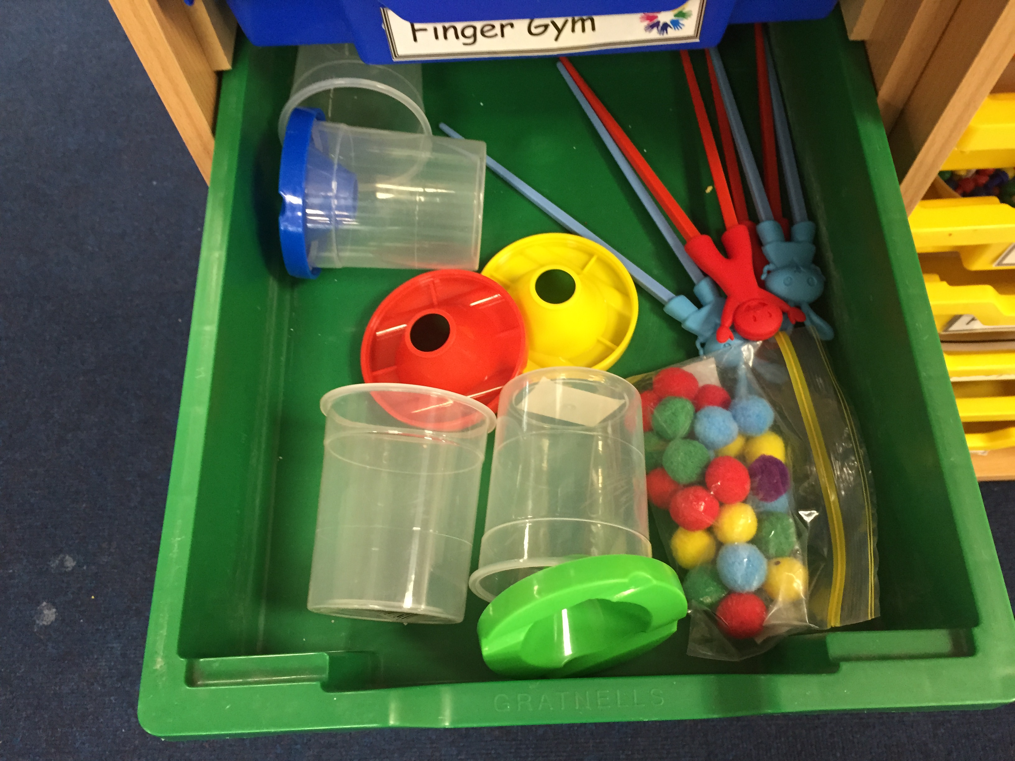
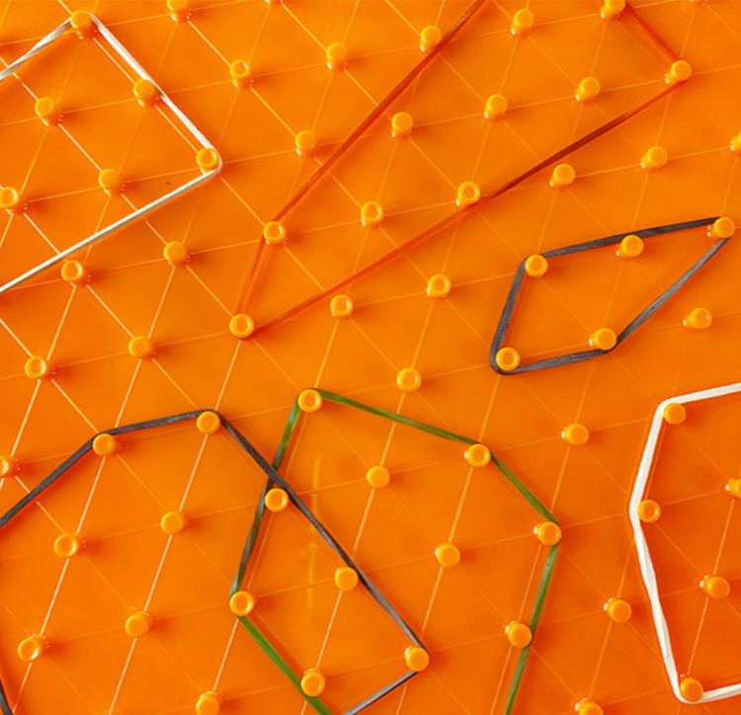
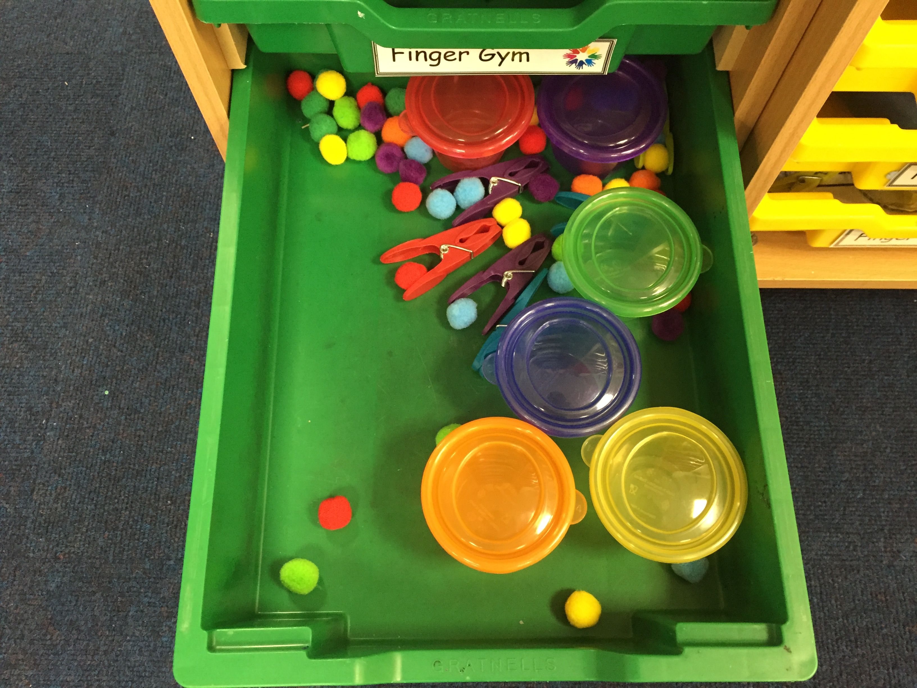
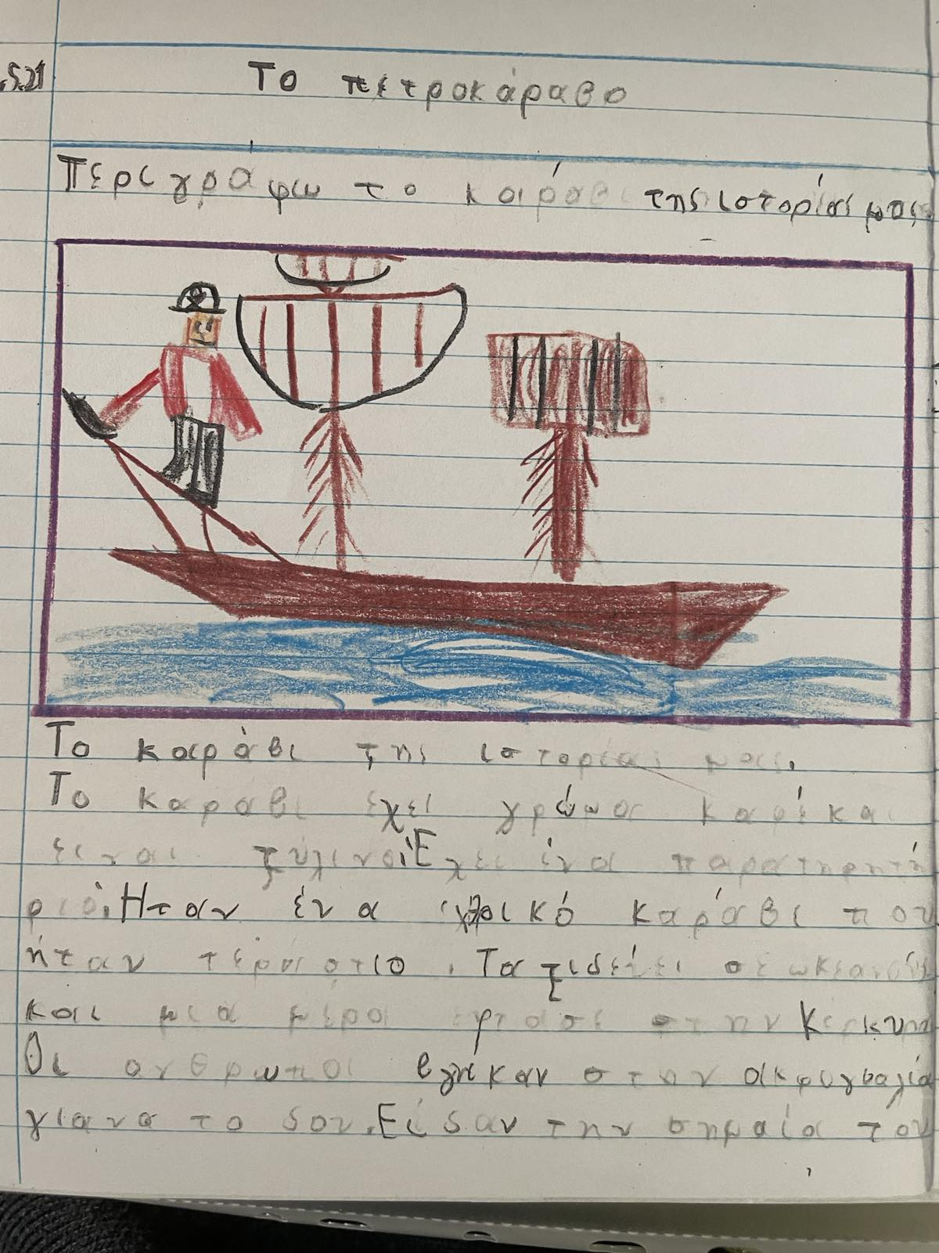
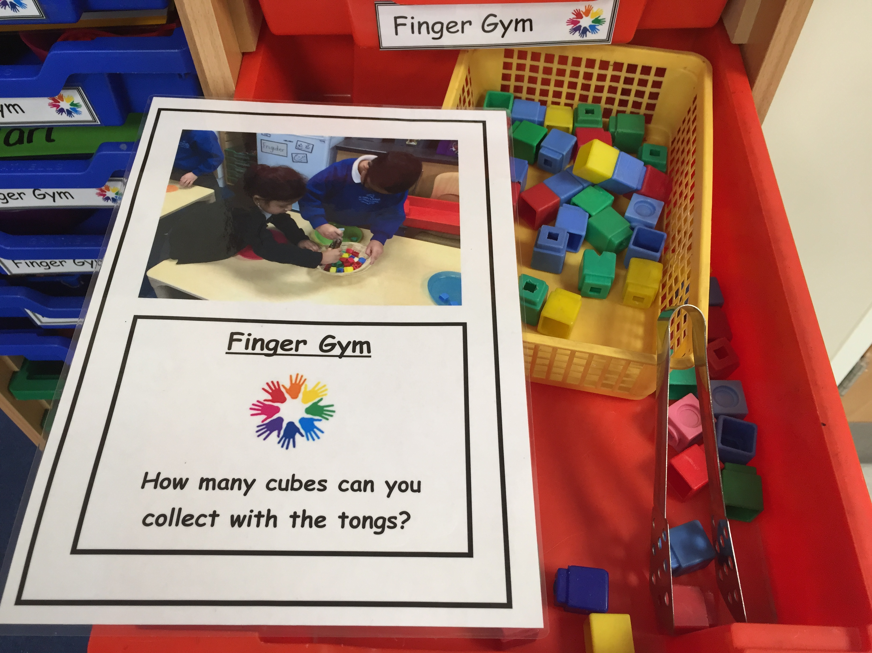
Fine Motor Skills:
Coloring, playdough, tweezers with small items, clothespins, elastic bands, threading yarn through beads or buttons

Slide 33
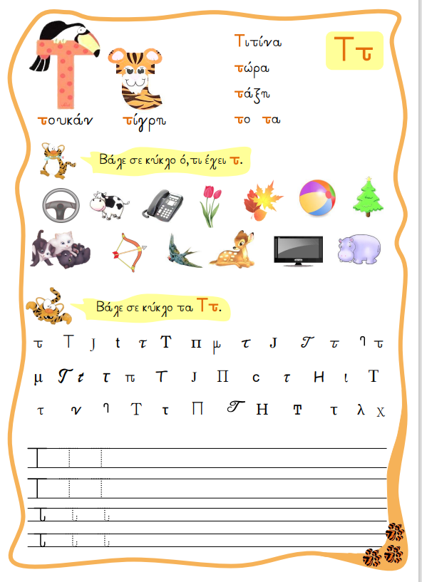
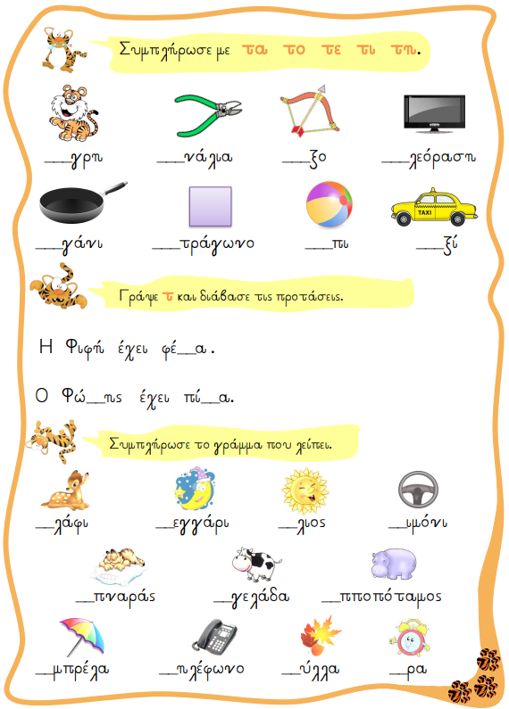
Day 2:
Syllables and Reading Card
Building words and sentences
Grammar endings
Writing exercises & spelling

Slide 34
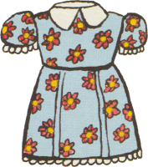



φο
φυ
φα
φε
Notes:
φά: φάλαινα, φαράγγι, φάρος
φο: φόρεμα, φορτηγό, φοράω
φε: φεγγάρι, φέρνω, φέγγει
φυ: φύλλα, φυλακή
φι: φίδι, φίλος
φω: φωτιά, φωλιά,

Slide 35

φο
φυ
φω
φε

Slide 36
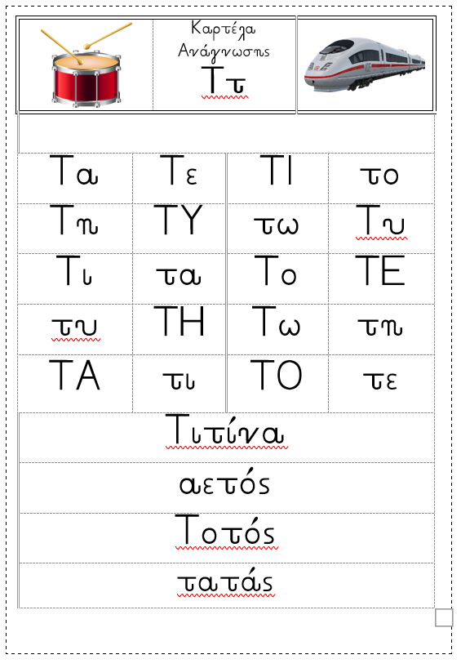
Reading Tab and Practice Hyphenation:
I say a syllable and the child points to it on the tab.
I point to a syllable and the child reads it on the tab.
I say a syllable and the child writes it down.
I say a word and the child writes the first syllable (only with consonants we were taught).
I say a syllable and the child says words that contain it.
I write words that contain the syllables and the child colors them.

Slide 37
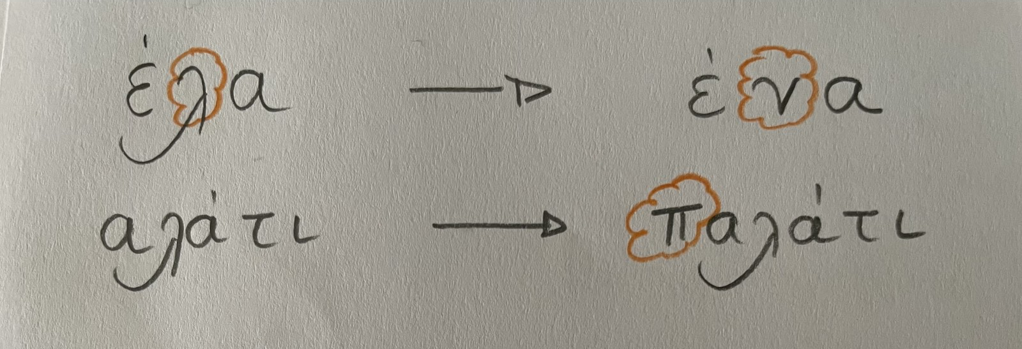
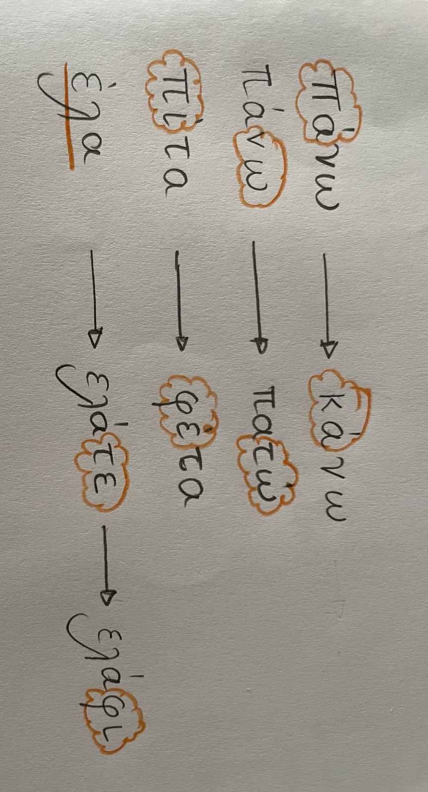
Reading Tab and Practice Hyphenation:
1. I change, add or remove a letter and the child reads.
2. I change or add a syllable and the child reads it.
Notes:
Όλες οι δραστηριότητες μπορούν να καταγράφονται σε ένα πρόχειρο τετράδιο που το παιδί μπορεί αν θέλει να το φέρνει στην τάξη και να μου δείχνει τη δουλειά του.

Slide 38
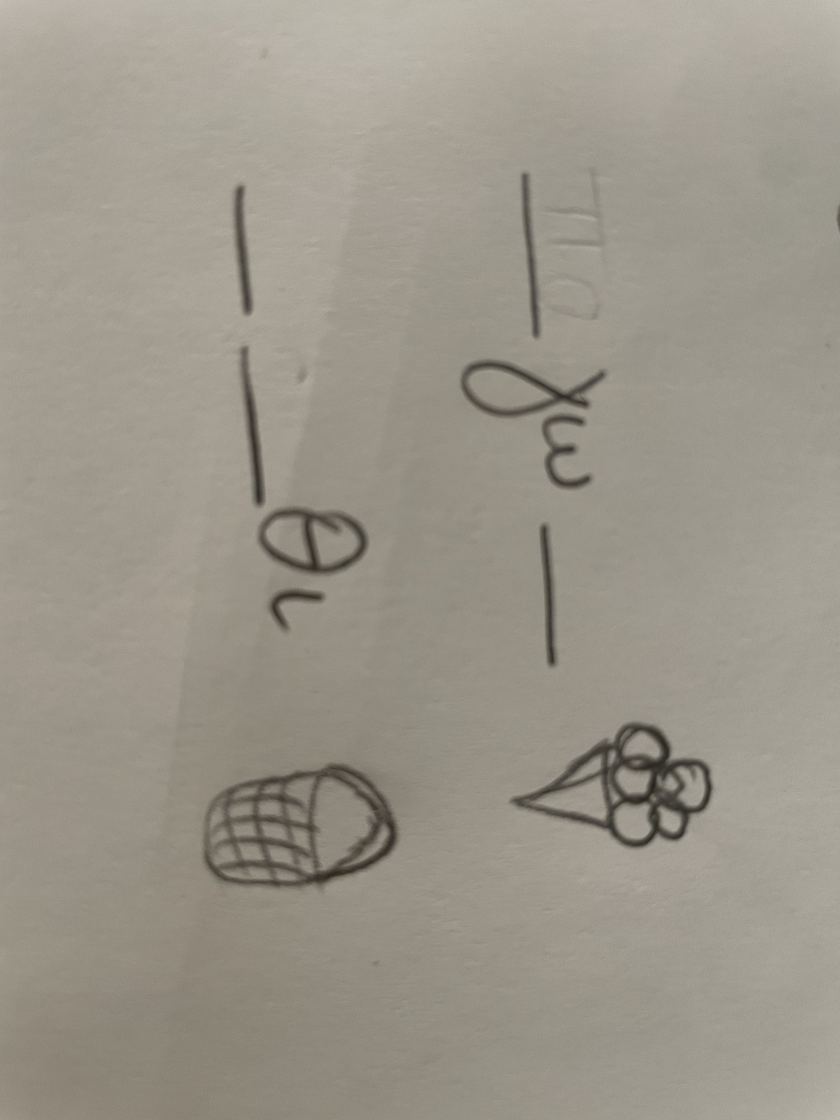
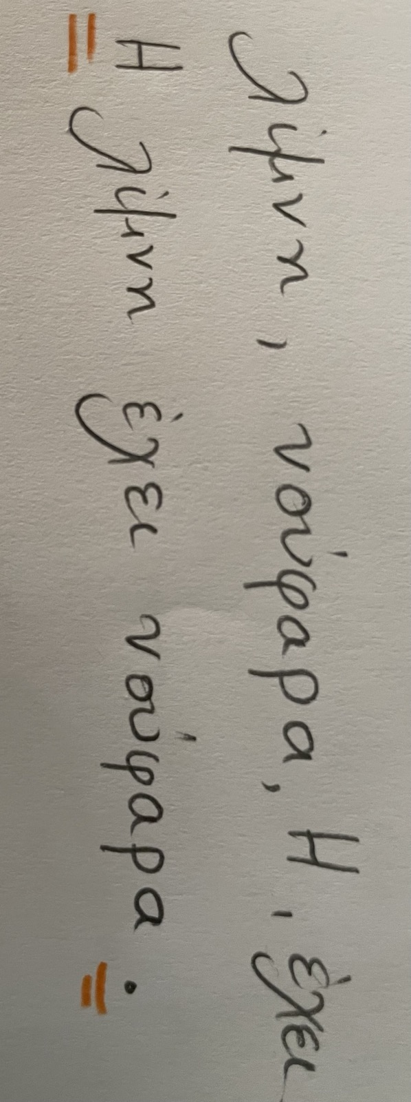
Reading Tab and Practice Hyphenation:
1. I write part of a word and the child fills in the missing syllables.
2. I give mixed words and the child makes the sentence.
Notes:
Όλες οι δραστηριότητες μπορούν να καταγράφονται σε ένα πρόχειρο τετράδιο που το παιδί μπορεί αν θέλει να το φέρνει στην τάξη και να μου δείχνει τη δουλειά του.

Slide 39
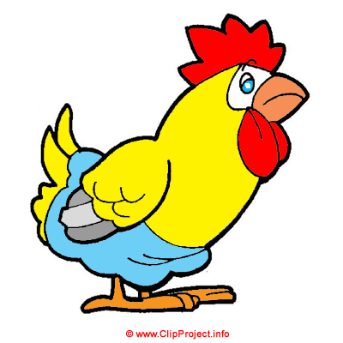
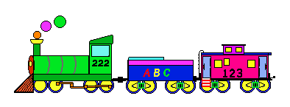
Τώρα μπορείς να βάλεις τις λέξεις στη σειρά για να φτιάξεις την πρόταση?
κότα
καπέλο
η
ένα
φοράει
Μηχανικός
στον πίνακα

Slide 40

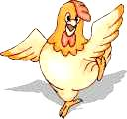
Μήπως κάτι λείπει από την προτασούλα μας?
Η
κότα
φοράει
ένα
η
καπέλο
.
?
!

Slide 41
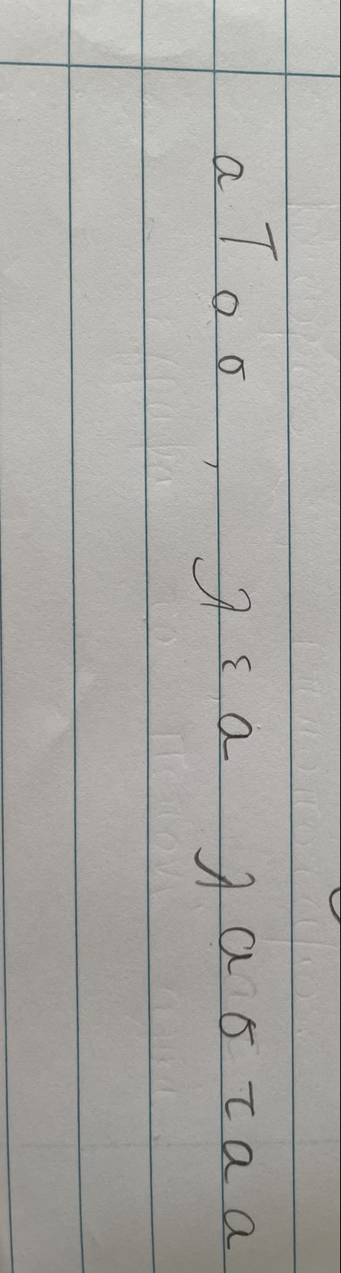
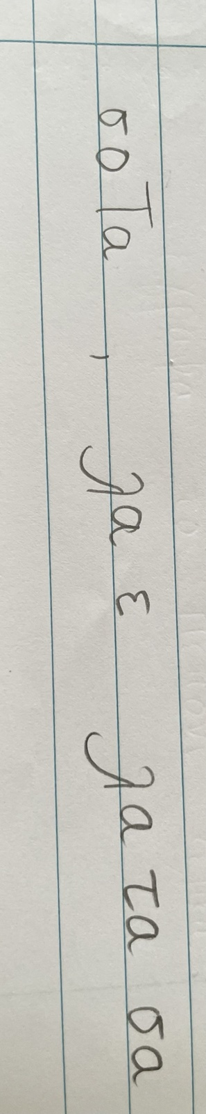
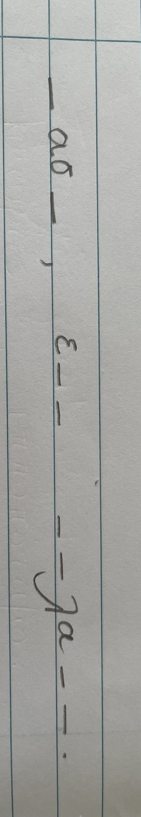
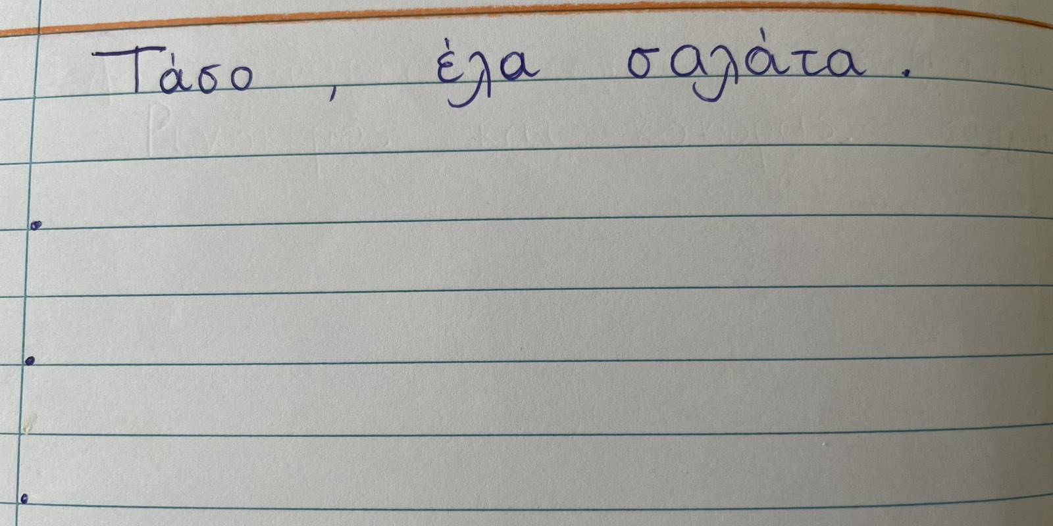
Ορθογραφία
Ways to practice:Γράφω 2-3 φορές. Μετά γράφω χωρίς να τη βλέπω
Συμπληρώνω τα γράμματα που λείπουν και βάζω τόνο.
Βάζω τα γράμματα στη σειρά.
Βάζω τις συλλαβές στη σειρά.

Slide 42
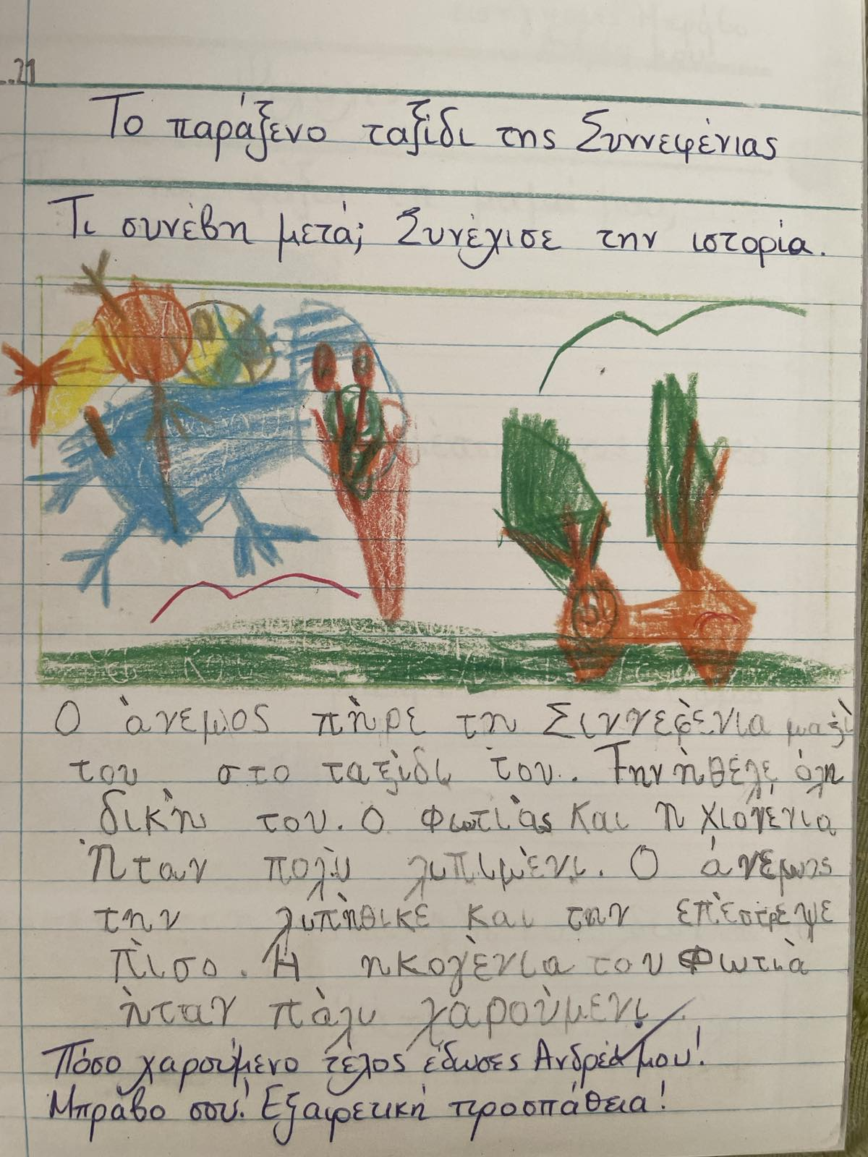
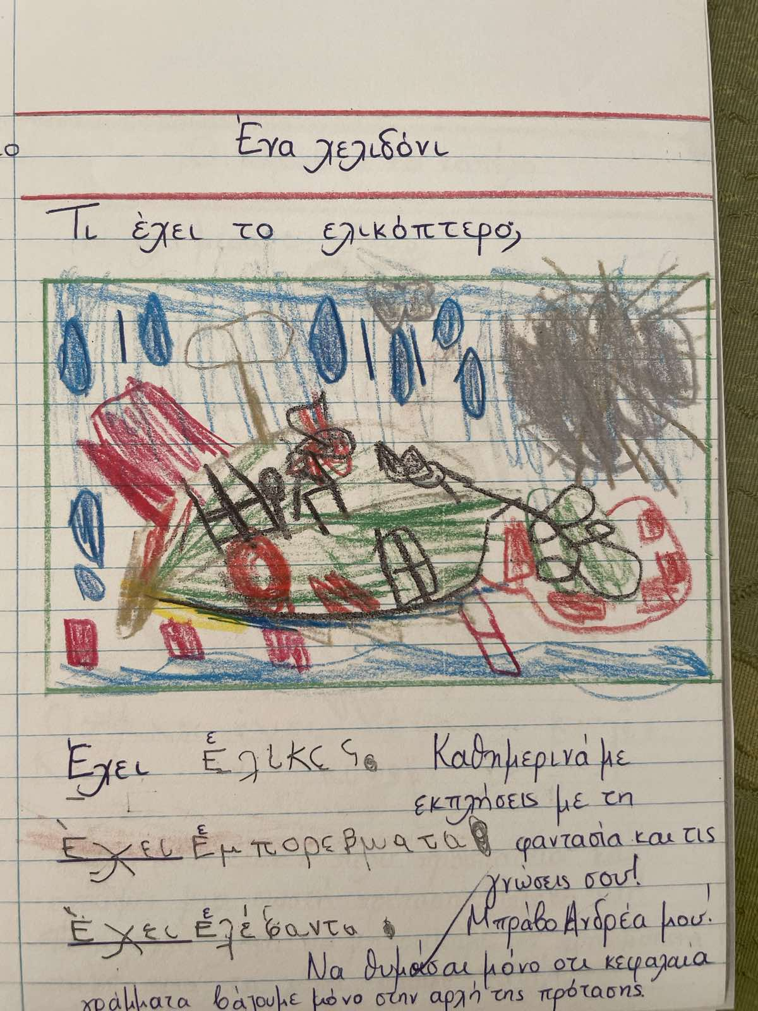
Day 3:
Syllable practice – repetition
Grammar concept – revision
Creative writing and imagination
Notes:
Θέλουμε να παράξουν ιδέες, να ενεργοποιήσουν τη φαντασία τους, να χρησιμοποιήσουν τυχόν γνώσεις που έχουν πάνω σε ένα θέμα που τους ενδιαφέρει και να καταγράψουν προτάσεις χρησιμοποιώντας όλα αυτά.

Slide 43




Grade A Objectives - Mathematics:

Slide 44
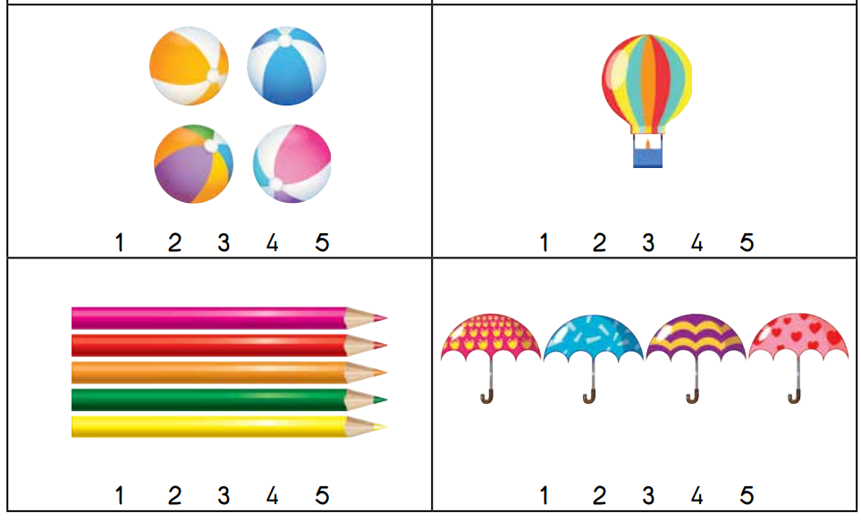

Grade A Objectives - Mathematics:
Recognition of numbers up to 10 : symbol and quantity.

Slide 45




Grade A Objectives - Mathematics:
2. Addition and subtraction up to 10.

Slide 46


Grade A Objectives - Mathematics:
3. Recognition of numbers up to 100: symbol and quantity.
4. Count up to 100.

Slide 47


Grade A Objectives - Mathematics:
4. Multiplication
Notes:
Τι αναμένω: Έννοια πολλαπλασιασμού ως επαναλαμβανόμενη πρόσθεση μέσα από εικόνες ή πραγματικό υλικό.
Τι δεν αναμένω: Νοερό υπολογισμό μιας πρότασης πολλαπλασιασμού.

Slide 48

Grade A Objectives - Mathematics:
5. Division
As sharing
Notes:
Τι αναμένω: Έννοια διαίρεσης ως δίκαιο μοίρασμα μέσα από εικόνες ή πραγματικό υλικό.
Τι δεν αναμένω: Νοερό υπολογισμό μιας διαίρεσης.

Slide 49

Communication:
Every Friday 07:45 – 08:25 (room next to the teachers' office)
School phone: 25694410

